Slide 1
Neural Network
Introduction
- what is neural network?
- what is learning?
Training Perceptron
- Gradient Descent Method
- Widrow-Hoff Procedure
- Generalized Delta Procedure
- Error Correction Procedure
Training Multi Layer Perceptron
- Backpropagation Method
Hopfield Net and Hamming Net
Self Organizing Feature Map

Slide 2
INTRODUCTION TO NEURAL NETWORKS AND LEARNING

Slide 3
What is Neural Network?
Computational model inspired by biological Neuron, cells perform information processing in brain
Systems are trained rather than programmed to accomplish tasks
Successful at solving problems proven difficult or impossible by using conventional computing techniques
* Formal Definition : A Neural Network is a non-programmed adaptive information processing system based upon research in how the brain encodes and processes information

Slide 4
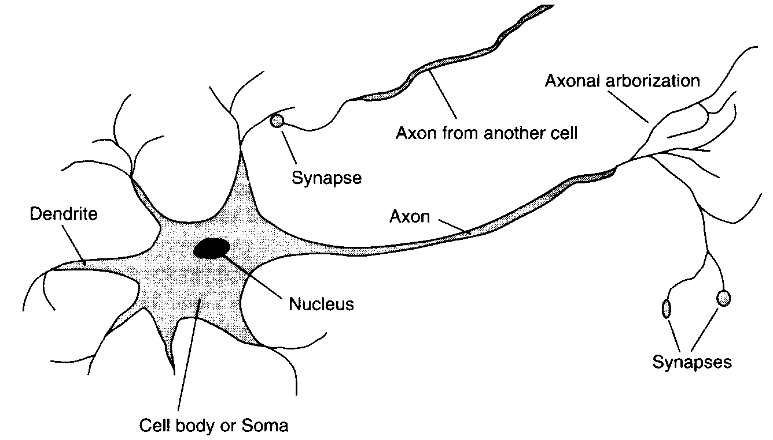
Biological Neuron
Excerpted from Artificial Intelligence: Modern Approach
by S. Russel and P. Norvig

Slide 5
Properties of Biological Neuron and Brain
Neurotransmission
  by means of electrical impulse effected by chemical transmitter
  Period of latent summation
    generate impulse if total potential of membrane reaches a level : firing
  excitatory - inhibitory
Human Brain
  Cerebral cortex
    Areas of Brain for specific function
  10¹¹ neurons
  10⁴ synapses per neuron
  10⁻³ sec cycle time (computer : 10⁻⁸ sec)

Slide 6

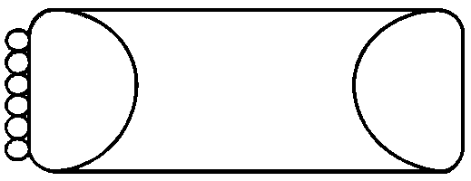

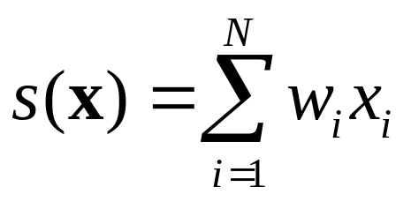


Computational Model of a Neuron
SOMA
T
Dendrites
(input)
Summer
Threshold
Axons
(output)
synapses
1
0

Slide 7
What Makes Up a Neural Network?
Neural Net | Neurobiology
Processing Element | Neuron
Interconnections Scheme | Dendrites and Axons
Learning Law | Neuro Transmitters

Slide 8
Neural Net vs. Von Neumann Computer
Neural Net | Von Neumann
Non-algorithmic | Algorithmic
Trained | Programmed with instructions
Memory and processing elements the same | Memory and processing separate
Pursue multiple hypotheses simultaneously | Pursue one hypothesis at a time
Fault tolerant | Non fault tolerant
Non-logical operation | Highly logical operation
Adaptation or learning | Algorithmic parameterization modification only
Seeks answer by finding minima in solution space | Seeks answer by following logical tree structure

Slide 9
What is Learning ?
Concepts of inductive learning (learning from example)
  Example : (x,f(x))
  Inductive inference
    [collection of examples of (x,f(X))] → h(X)
  Hypothesis : h
    approximation of f, the agent’s belief about f ( h≈f )
    hypothesis space : set of all hypothesis writable.
  Bias
    Any preference for one hypothesis over another.
    there’re many consistent hypotheses.

Slide 10
  Examples of biased hypothesis
Representation of functions
  expressiveness : perceptron can’t learn XOR
  efficiency : # of examples for good generalization
  ‘a good set of sentences’
(a)
(b)
(c)
(d)
examples
hypothesis1
hypothesis2
hypothesis3

Slide 11
Learning Procedure
Collect a large set of examples
Divide it into two disjoint sets :
training set & test set
Use the learning algorithm with the training set as examples to generate a hypothesis H
Measure the percentage of examples in the test set that are correctly classified by H.
Repeat steps 1-4 for different sizes of training sets & different randomly selected training sets of each size

Slide 12
SINGLE THRESHOLD LOGIC UNIT(TLU)

Slide 13



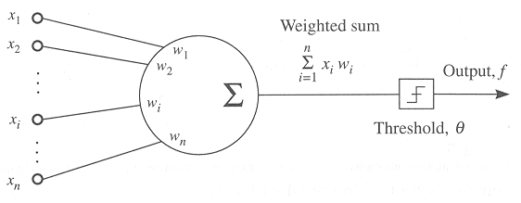
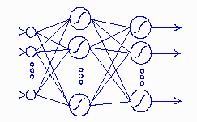
S-R Learning with TLU/NN
Introduction :
Experiences
  sensory data set
  paired with proper action
Knowledge
  function
  from sensory data
  to proper action
Representation
  1. single TLU with adjustable weights
  2. Multi layer perceptron

Slide 14





Training Single TLU
TLU geometry
  TLU definition
    internal knowledge representation
    an abstract computation tool that calculates
Input :
output :
transfer :
weight :
threshold :
1
0

Slide 15
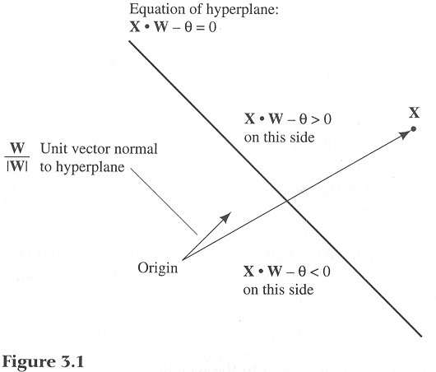
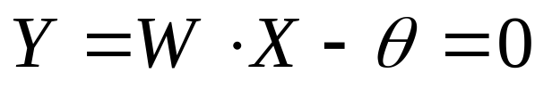
  Geometric Interpretation of TLU computation
    0 if X is in one side of a hyperplane,
    1 if X is in the other side of the hyperplane.
A hyper plane in R^{n} space:

Slide 16
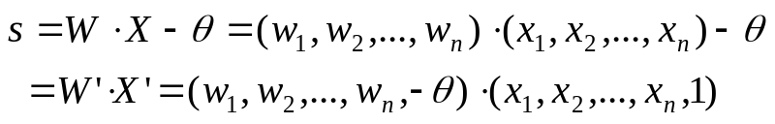
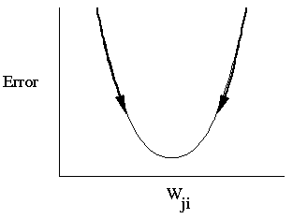
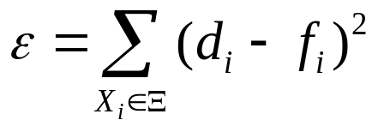



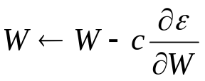
Training Single TLU : Gradient Descent Method
Definition
Gradient Descent Methods
  Learning is a search over internal representations,
  which maximize/minizie some evaluation function :
  ε can be minimized by gradient descent : greedy method
How to update W??
  Incremental learning : adjust W that slightly reduce e for one X_{i}
  Batch learning : adjust W that reduce e for all Xi
TLU output :
desired output :

Slide 17
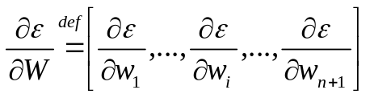


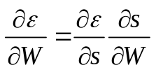
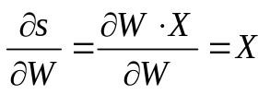
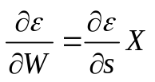
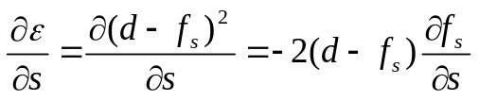
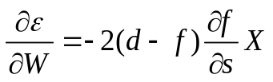
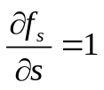

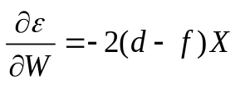
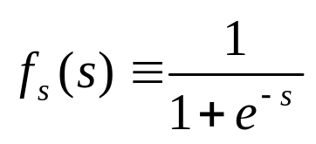
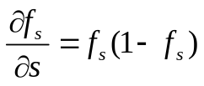
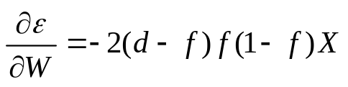
Gradient descent learning rule (Single TLU, Incremental)
Gradient
by Definition
By Chainrule
case 1)
case 2)

Slide 18
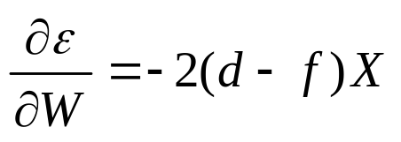
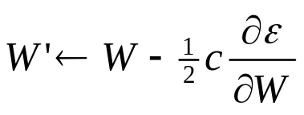



Training Single TLU : Widrow-Hoff Procedure
Activation function:

Slide 19
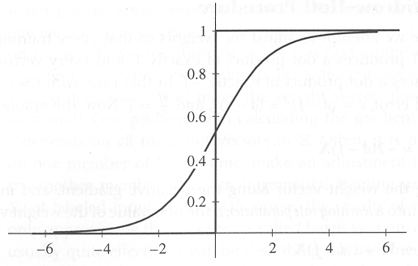


Training Single TLU : Generalized Delta
Activation function:
Sigmoid function

Slide 20
Training Single TLU : Error Correction Procedure
Learning rule
  Activation function : 0/1 threshold function
  Adjust weights, only when (d-f) = (1 or -1)
  Use the same weight update gradient
Termination of Learning Procedure
  Error Correction Procedure
    If there exists some weight vector W, that produces a correct output for all input vectors, the error-correction procedure will find such a weight vector and terminate.
    If there exists no such vector W, error-correction procedure will never terminate.
  Widrow-hoff and Generalized Delta procedures
    Minimum squared-error solutions are found even when there exist no perfect solutions W.
1
0

Slide 21
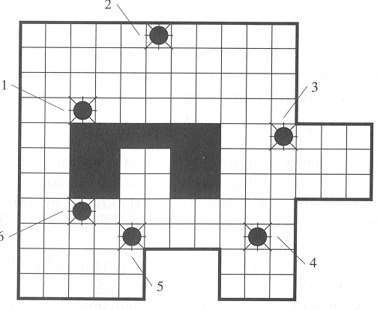
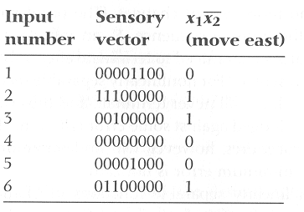
  Example problem
0/1 situations are linearly separable!
Home work !!

Slide 22
NEURAL NETWORKS

Slide 23
Neural Networks
Why Neural Networks?
  A single TLU is not enough !
  There are sets of stimuli and responses that cannot be learned by a single TLU.
  (non linearly separable functions)
  Let’s use a network of TLUs !
Structure of Neural Networks
  Feed forward net: There is no circuit in the net, output value is dependent on only input values.
  Recurrent net : There are circuits in the net, output value is dependent on input & history.

Slide 24
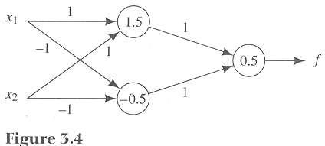
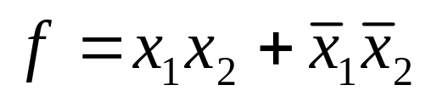
An Example of a Neural Network
3 layer feed forward network
  Input layer
  Hidden layer
  Output layer

Slide 25

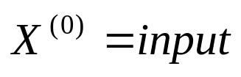
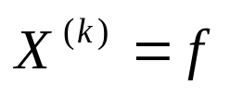
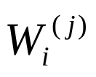


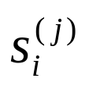


Neural Network: Notations
j-th Layer output vector :
Input vector :
Final layer output vector :
Weight vector of i-th TLU in j-th layer
Input to a i-th TLU in j-th layer (activation)
Number of TLUs in j-th layer :

Slide 26
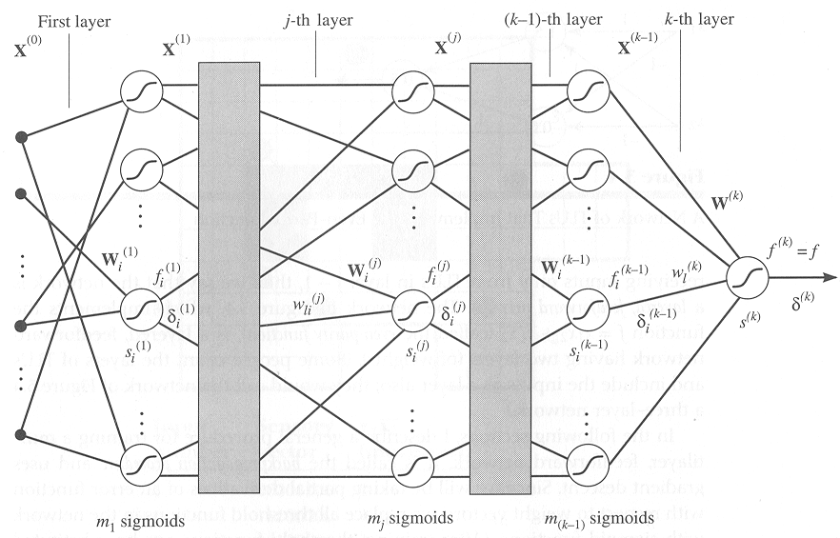
A general, k-layer feed forward network

Slide 27
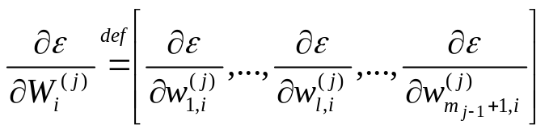
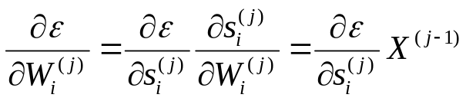
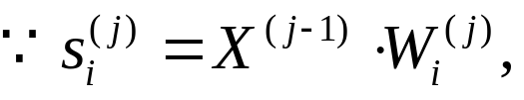
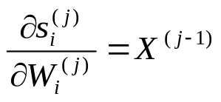
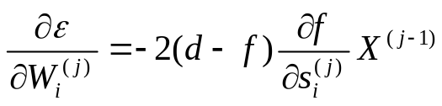
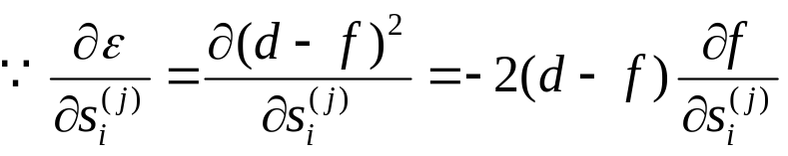

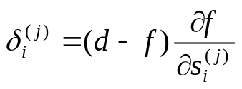
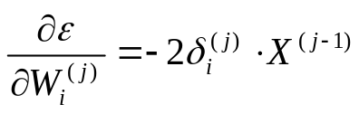

Backpropagation Method(1/3)
Gradient of squared error with respect to weight vector
Using activation variable and the chain rule
Let activation error influence
Weight update rule is derived:

Slide 28
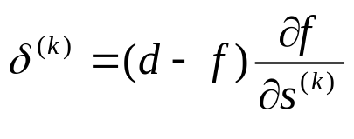


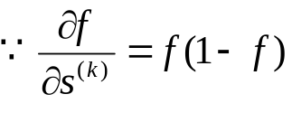

Backpropagation Method(2/3)
Weight update rule in final layer
  By definition
  Since f is the sigmoid function of
  Backpropagation weight adjustment rule for the single TLU in the final layer:

Slide 29
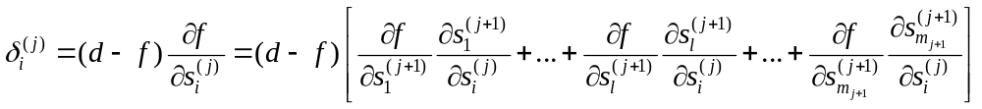
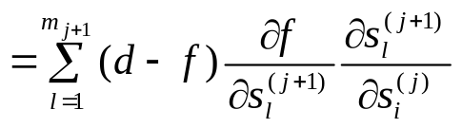
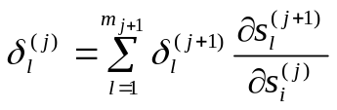
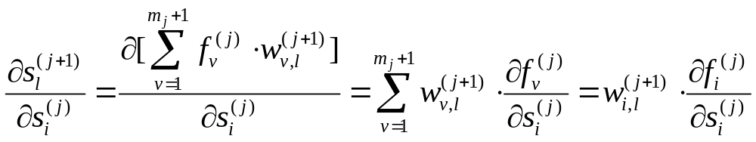
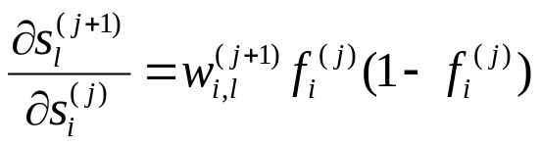
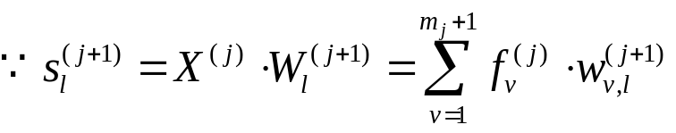

Backpropagation Method(3/3)
Weight update rule in intermediate layers
  Using chain rule

Slide 30
Recurrent Neural Networks
: Hopfield Network
Proper when exact binary representations are possible.
Can be used as an associative memory or to solve optimization problems.
The number of classes (M) must be kept smaller than 0.15 times the number of nodes (N).

Slide 31
OUTPUTS(Valid After Convergence)
x’₀
x’₁
x’_{N-2}
x’_{N-1}
. . . . .
x₀
x₁
x_{N-2}
x_{N-1}
INPUTS(Applied At Time Zero)

Slide 32



Recurrent Neural Networks
: Hopfield Network Algorithm(1/2)
Step 1 : Assign Connection Weights.
Step 2 : Initialize with unknown input pattern.

Slide 33


Recurrent Neural Networks
:Hopfield Network Algorithm (2/2)
Step 3 : Iterate until convergence.
Step 4 : goto step 2.
1
0
-1

Slide 34


Slide 35


Recurrent Neural Networks
: Hamming Net
Optimum minimum error classifier
  Calculate Hamming distance to the exemplar for each class and selects that class with minimum Hamming distance
  Hamming distance = number of different bits
Advantages Over Hopfield Net:
  Hopfield Net is worse than or equivalent to Hamming Net
  Hamming Net requires fewer connections
  The number of connections in Hamming Net grows linearly
  N² vs NM + M² → M(N+M)
  N=100, M=10 10000 1100 ≈ NM (1000)
  N >> M

Slide 36
OUTPUT(valid after MAXNET converge)
Y₀
Y₁
Y_{M-2}
Y_{M-1}
(Class)
MAXNET
PICKS
MAXIMUM
T_{kl}
CALCULATE
MATCHING
SCORES
W_{ij}
x₀
x₁
x_{N-2}
x_{N-1}
(Data)
INPUT(applied at time zero)

Slide 37


Recurrent Neural Networks
: Hamming Net Algorithm
Step 1. Assign Connection Weights and offsets
in the lower subnet :
in the upper subnet : for lateral inhibition

Slide 38


Step2. Initialize with unknown input pattern
Step3. Iterate until convergence
This process is repeated until convergence.
Step4. Go to step 2
f_{t}:
1
1

Slide 39


Slide 40
Self Organizing Feature Map
Transform input patterns of arbitrary dimension to discrete map of lower dimension
  clustering
  representation by representative
Algorithm
  1.initialize w’s
  2. find nearest cell
  i(x) = argmin_{j} || x(n) - w_{j}(n) ||
  3. update weights of i(x) and its neighbors
  w_{j}(n+1) = w_{j}(n) + η (n) [ x(n) - w_{j}(n) ]
  4. reduce neighbors and η
  5. Go to 2
x₁
x₂
NE(n)
j
NE(n+1)

Slide 41
SOFM Example
Input sample : random numbers within 2-D unit square
100 neurons ( 10x10)
Initial weights : random assignment (0.0~1.0)
Display
  each neuron positioned at w₁, w₂
  neighbors are connected by line

Slide 42


Input samples
Initial weights

Slide 43



After 25 iterations
After 1000 iterations
After 10000 iterations
➔ Programming Assignment!!

